Slide 1

Vel Tech Rangarajan Dr. Sagunthala R&D Institute of Science and Technology
School of Computing
Department of Computer Science and Engineering
10211CS224 / FULL STACK APPLICATION DEVELOPMENT (JAVA)
PROJECT REVIEW : MILESTONE PROJECT – 1
Date: 23-03-2026
Subscription-Based Membership Engine with Tiered Logic
SDG: SDG No – SDG Title(Example: SDG 4 – Quality Education)
Presented By:
STUDENT NAME – VTU25488 – Reg.No. – 23UECS0616
Courses Handling Faculty:
Dr. Sumithra M.

Slide 2
INTRODUCTION
Subscription-Based Membership Engine with Tiered Logic
Modern digital platforms need flexible, automated membership management systems.
Manual subscription handling leads to billing errors and poor user experience.
Tiered pricing enables businesses to serve users across different budget levels.
This system automates plan upgrades, downgrades, renewals, and access control.
Built using Java Full Stack with Spring Boot backend and React frontend.
Supports Basic, Standard, and Premium membership tiers with distinct feature sets.
1
2
3
4
5
6
7
8
9

Slide 3
PROBLEM STATEMENT
In the current digital ecosystem, most subscription platforms lack a fully intelligent and automated system for managing memberships. Organizations often rely on manual processes for billing, plan assignment, and access control, which leads to frequent errors, delayed service delivery, and poor user experience.Additionally, existing solutions are unable to implement dynamic tier-based logic, making it difficult to automatically assign features, permissions, or privileges according to a user’s subscription level. Handling plan upgrades, downgrades, renewals, and expirations is often cumbersome and prone to mistakes, resulting in inconsistent service delivery and revenue leakag
1
2
3
4
5
6
7
8
9

Slide 4
OBJECTIVE(S)
1
2
To design and develop a full-stack Subscription-Based Membership Engine with tiered plan logic using Java Spring Boot and React.
To implement automated billing, tier-based access control, plan upgrade/downgrade logic, and renewal notifications.
3
4
5
6
7
8
9

Slide 5
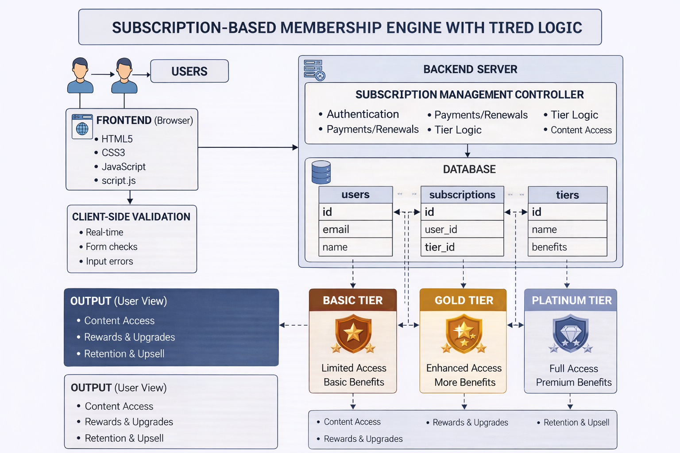
PROPOSED SYSTEM ARCHITECTURE
1
2
3
4
5
6
7
8
9

Slide 6
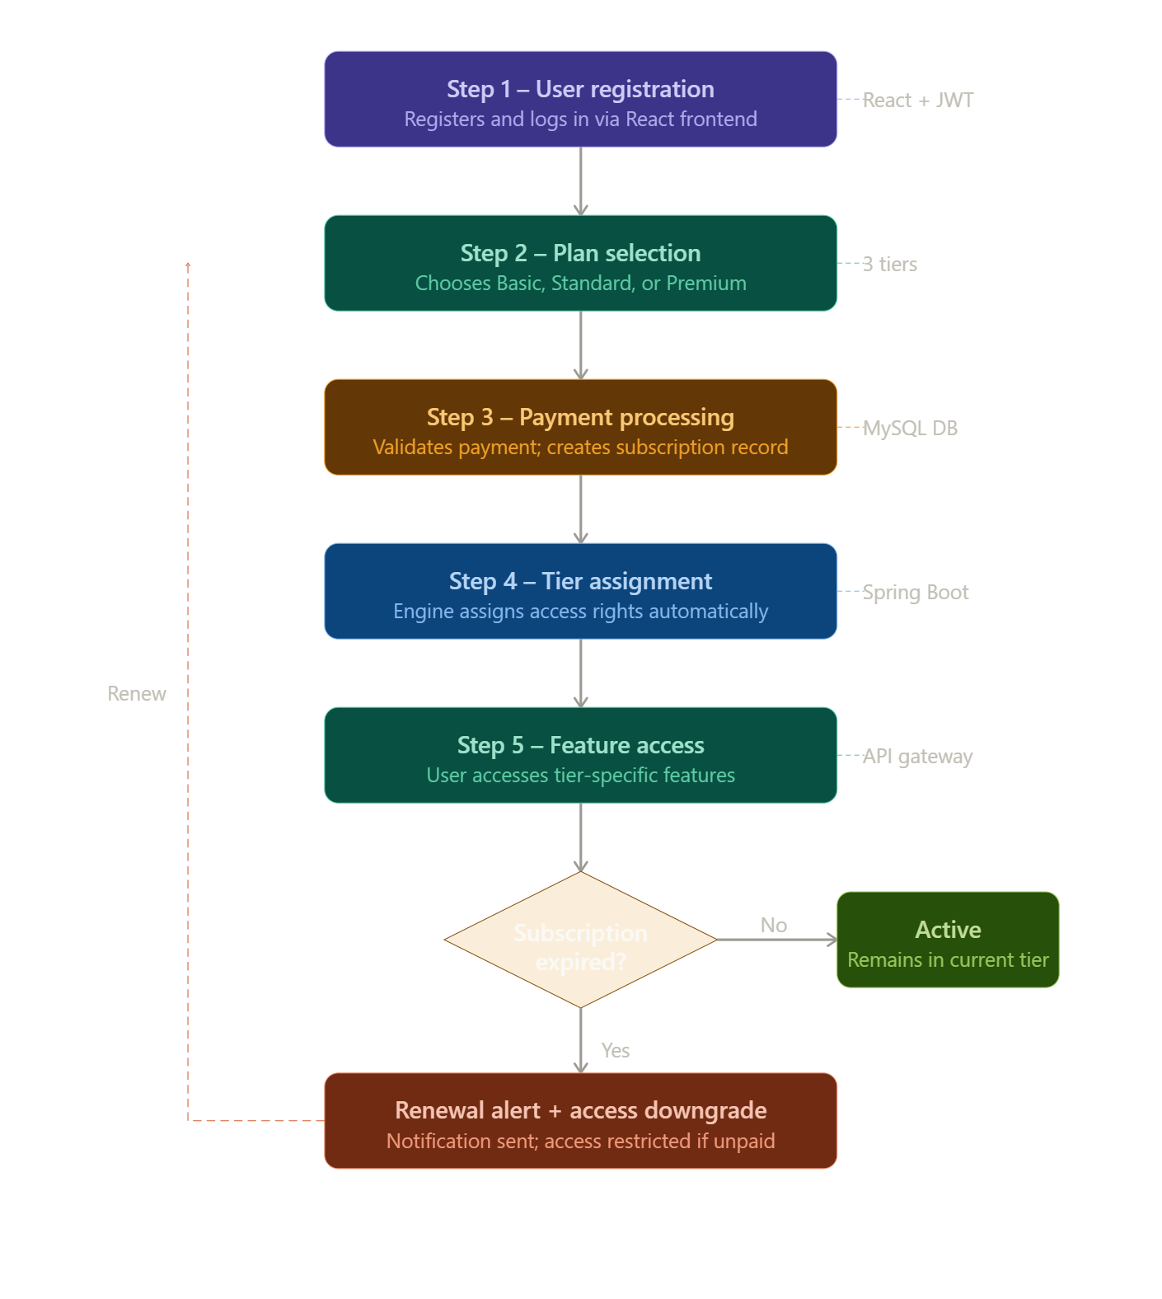
WORKFLOW
Workflow: User Registration → Plan Selection → Payment Processing → Tier Assignment → Feature Access
Step 1 – User registers and logs in via the React frontend portal.
Step 2 – User selects a membership tier (Basic / Standard / Premium).
Step 3 – Payment is validated; subscription record is created in the database.
Step 4 – Tiered logic engine assigns access rights and feature permissions automatically.
Step 5 – On expiry, system triggers renewal notifications and downgrades access if unpaid.
1
2
3
4
5
6
7
8
9

Slide 7
TECHNOLOGIES USED
Technologies Used:
Frontend: HTML, CSS, JavaScript.
Backend: PHP
Database: MySQL
Tools: XAMPP Server, Visual Studio Code, GitHub .
Hardware/Software Requirements:
Processor: Intel i3 or above
RAM: Minimum 4GB
Operating System: Windows 10/11
Browser: Google Chrome / Microsoft Edge
1
2
3
4
5
6
7
8
9

Slide 8
MODULE DESCRIPTION
Module Overview – Subscription-Based Membership Engine with Tiered Logic
Module 1: User Authentication & Registration
Handles user sign-up, login, JWT-based authentication, and secure session management.
Module 2: Subscription & Tiered Plan Management
Implements tiered logic engine for Basic, Standard, and Premium plans; handles upgrades, downgrades, and renewals.
Module 3: Billing & Payment Processing
Automates billing cycles, generates invoices, and sends renewal/expiry notifications via email.
Module 4: Admin Dashboard & Analytics
Provides admin panel to manage users, view subscription stats, revenue reports, and tier-wise analytics.
1
2
3
4
5
6
7
8
9

Slide 9
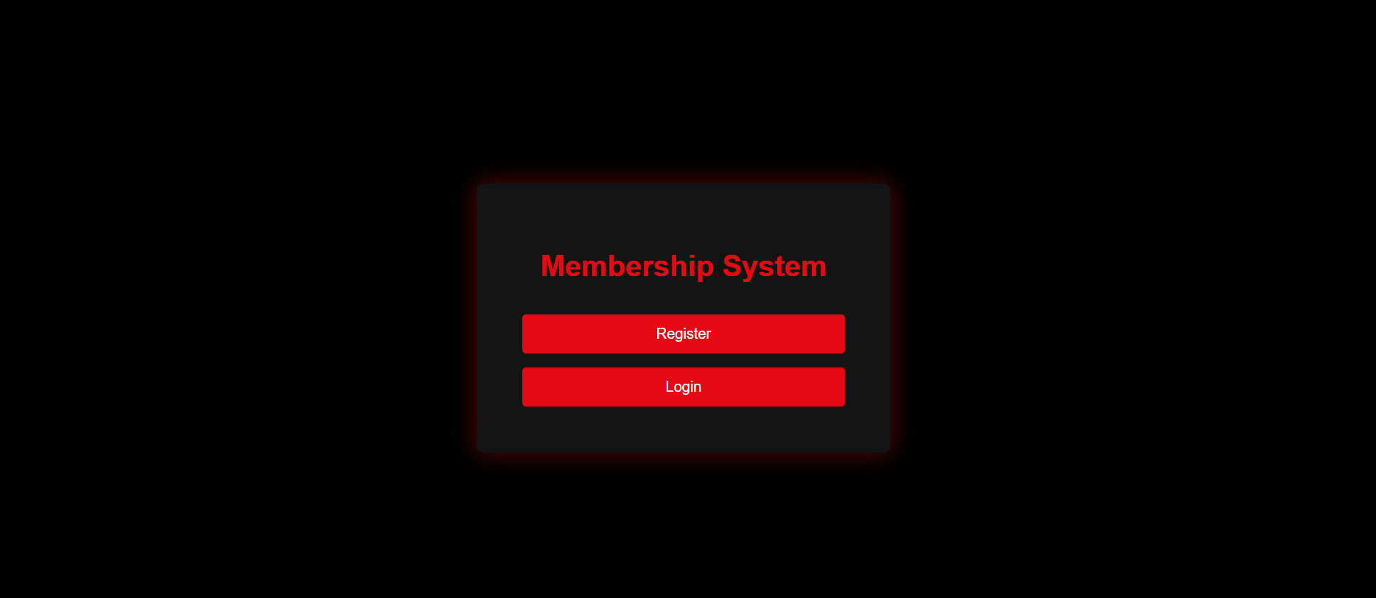
IMPLEMENTATION SCREENSHOTS
1
2
3
4
5
6
7
8
9

Slide 10
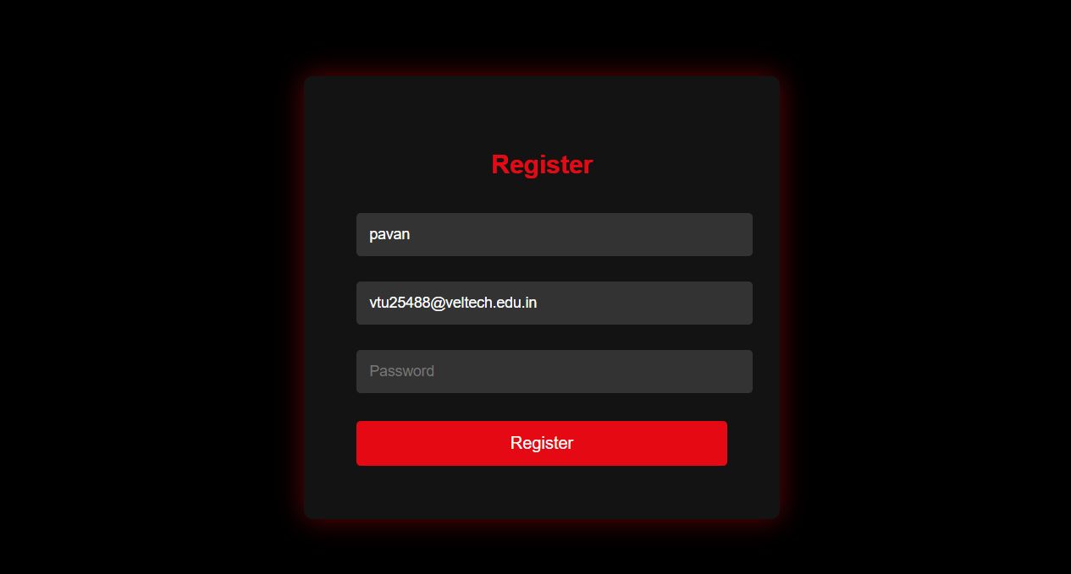
IMPLEMENTATION SCREENSHOTS
1
2
3
4
5
6
7
8(A)
9

Slide 11
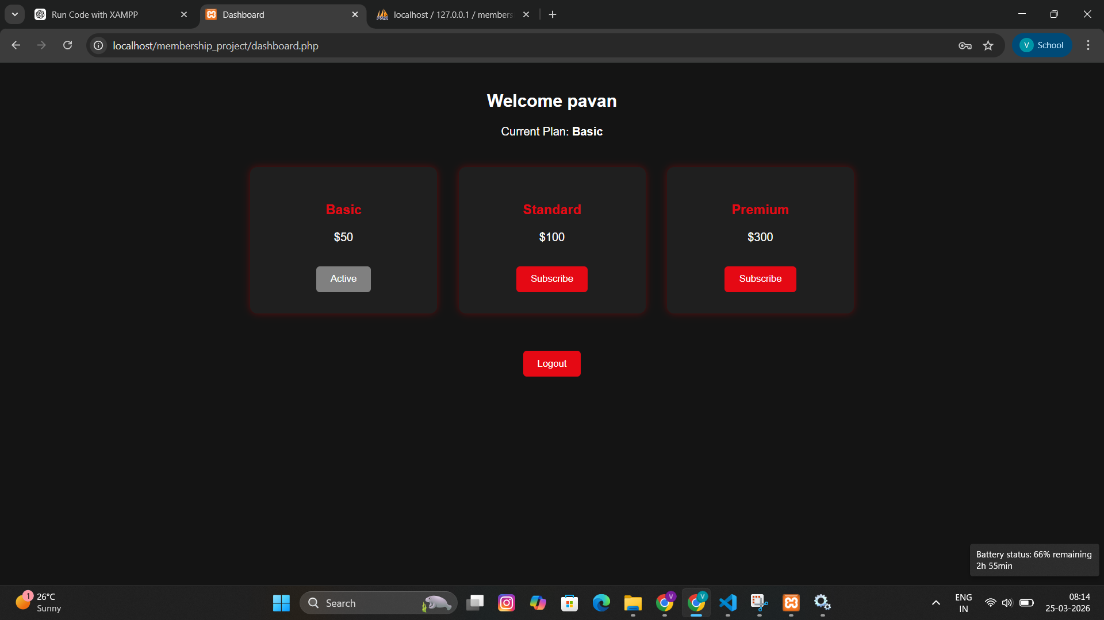
IMPLEMENTATION SCREENSHOTS
1
2
3
4
5
6
7
8(B)
9

Slide 12
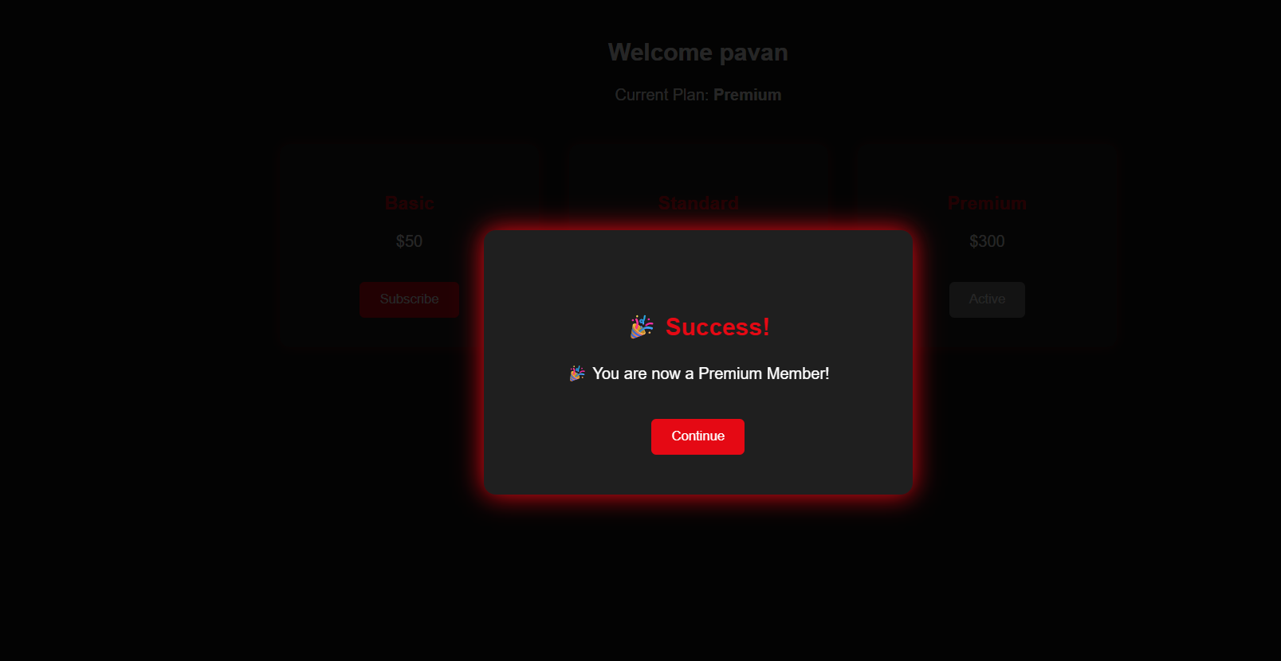
IMPLEMENTATION SCREENSHOTS
1
2
3
4
5
6
7
8(C)
9

Slide 13
ADVANTAGES & LIMITATIONS
1
Advantages:
Fully automated subscription lifecycle — no manual intervention needed.
Tiered logic ensures users get only the features they have paid for.
Scalable architecture supports growing user base with minimal changes.
Real-time billing and instant access control improves user satisfaction.
Admin dashboard provides complete visibility into revenue and membership analytics.
Limitations:
Payment gateway integration is simulated; real-world payment APIs require additional setup.
No mobile app; currently accessible only via web browser.
Advanced fraud detection and dispute resolution not yet implemented.
2
3
4
5
6
7
8
9

Slide 14
Thank you

